Slide 1
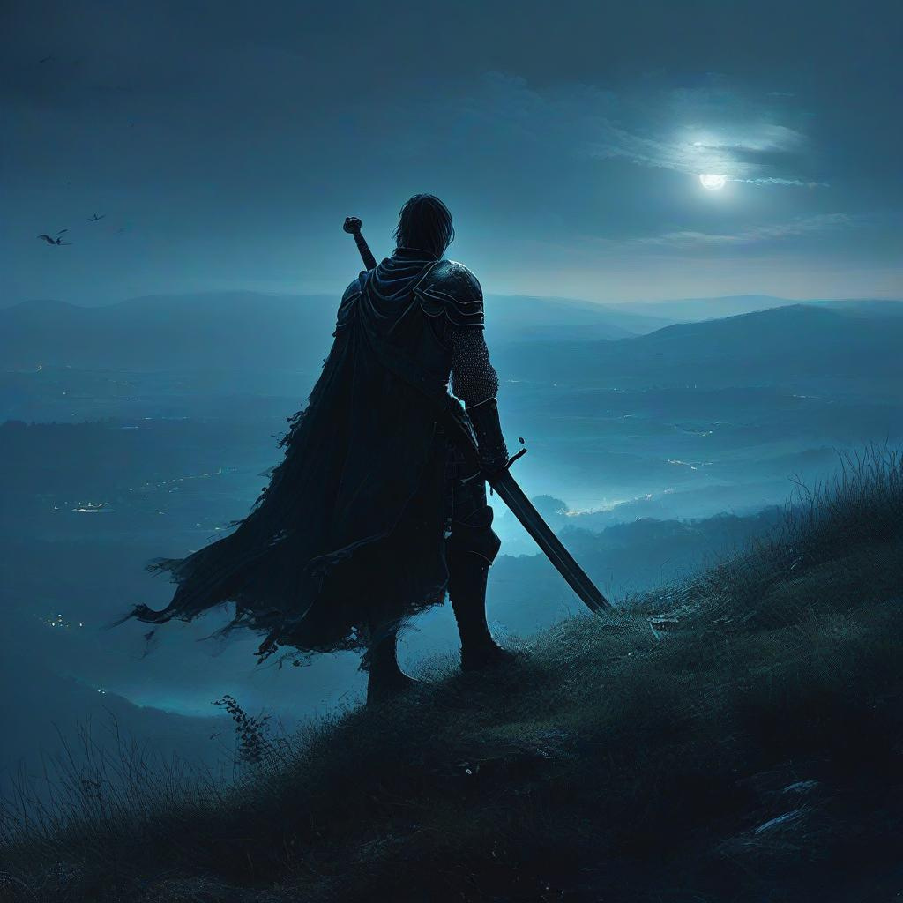
A RATHNA KAMAL WRITINGS PRESENTS,
A CHANCE
OF LIFE
A FICTIONAL STORY INSPIRED FROM THE WORLD OF
“THE WITCHER”.

Slide 2
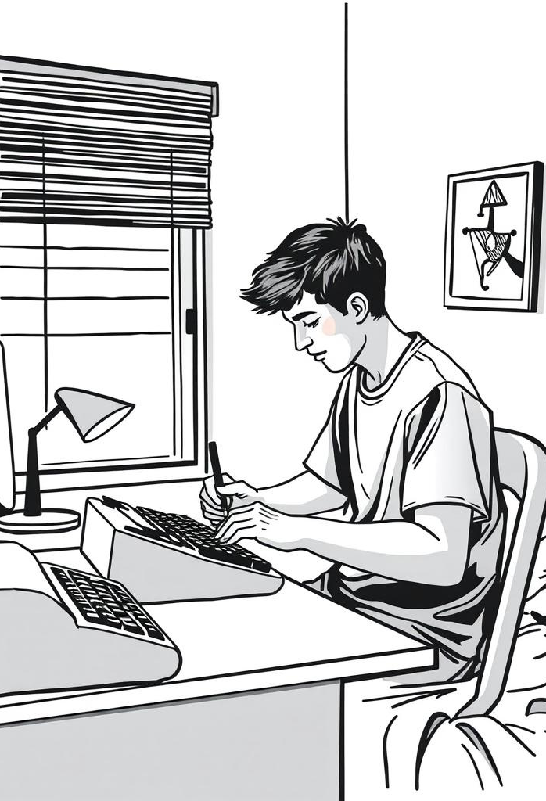
GREETINGS
My name is Jonnalagadda Rathna kamal; An aspiring Story writer and have a keen eye for creative regarding quest development and designing it. This is my story application in regards to joining in your company” CD Projekt RED” in Quest writing and Development.
The story, the Characters, locations and places are taken from The world of the “Witcher”.
These were taken just for story and narrative purpose only, so that the reader can get familiar with it. Sorry for the Inconvenience.

Slide 3

Even though the places used belongs the world of “Witcher”; the story and characters seen are of pure fiction (Most of them). given PPT will be a Read -Only File. The slide show will be in it’s best format form so that you the “Reader” can enjoy.
Thank you.
-Rathna Kamal

Slide 4
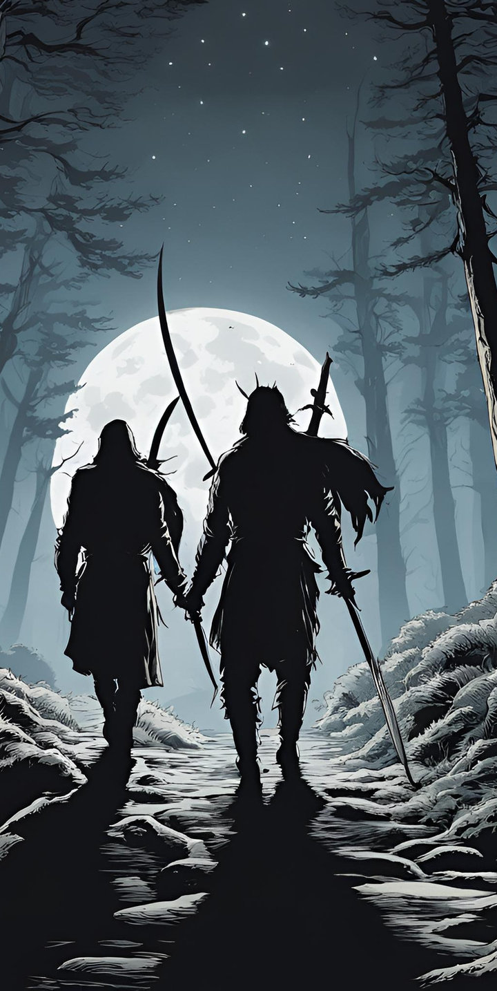
A START OF SOMETHING.
:The winds howling. Sound of the Distant animals making sure that the ‘Journey’ in which we are, not alone; Makes us prepared”.
‘Prepared for What?’ I asked; “For what is to come; The night always brings something to look forward” as the person speaks while smiling( a little bit).
Even though these words are off riddled, I was courageous enough to travel with a fellow companion. Outside the city walls, the woods and the journey through them at night time is and always dangerous in this world, But this...... This candidate; I presume is not. Says usually works at this time, probably a royal guard or a Hunter; but carries ‘2’ Swords on his back, weird, But fine by me.
I met this one in the nearby Inn; The people inside were having a competition; ‘The person who drinks 3 bottles and fights off the other wins’.
This one was sitting in a corner alone when I entered. I sat In front of him as the others are having ‘fun’ which I cannot Understand even.

Slide 5
This one was silent for most of the time; So I started by saying, ‘Greetings, I am a renounced writer of Novigrad, One sent by our Righteous King of Nilfgaard Himself to know about his majesties people and their wonderful lives under ‘their’ glorious rule.’
This person laughed a little bit and said “Good, what have you known? In your travels?”
‘A lot, the people are having their best lives under the glorious King’s eyes; Even though some of the rules are harsh, it is for their Best’ , I replied.
The Person, Seated himself straight and told me;
“Do you know, the Nilfgaardian soliders looted the nearby villages, killed the men and raped every single women and burned their counter-parts on pikes so that one will ever stand against them just because they thought; the Nilfgaardian soliders thought that these villages were helping the ‘rebels’ or your righteous king only let’s people like you to write only about his boasted achievements?”
I felt anger in his tone; But even then I stood up for my king as he was the one who took me in, raised me and helped to gain this job along with ‘good status’ in this society.

Slide 6
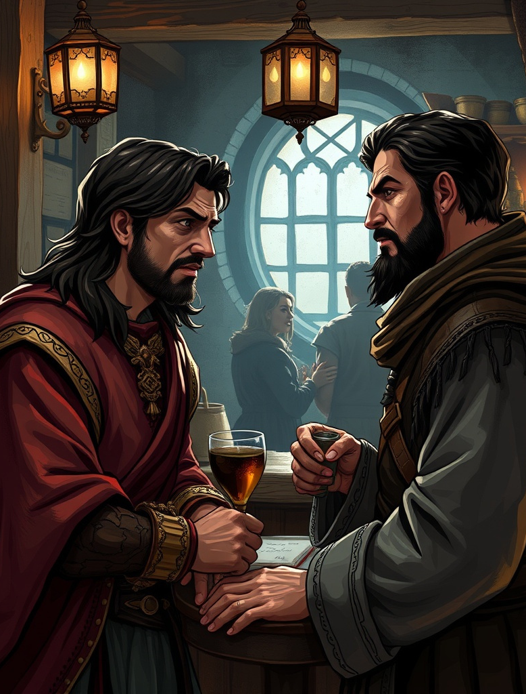
‘The villagers may helped them, may be not; We may not know the truth But the Nilfgaardians always fight for the protection of the people and not like those mad people in Skellige or those of Temeria. So, Please do not talk about our king or our protectors the Nilfgaardian soldiers Like that!.’
I raised my voice which was heard by the rest in the Inn. Well, the people in the Inn were mostly of Redania, But ‘there is no anger bound to the Drunkard’ they say. their hatred towards Nilfgaard made Me their special target. As the horde was approaching; One of them said, ‘ You are Nilfgaardian Spy aren't you?, Come here to check if we are ready to knell to you King’s gracious feet you c**t!?’ The other one continued ‘ Aye; This one’s a weed, need to be plucked out fast’.
As all of them were approaching me with one intent ‘TO Kill Me’; This person stood up, went towards them and......
I was stunned as what he told or given; He did something for sure, which made all the people scatter by themselves. The owner of the Inn thanked him and told me to ‘Get THE HELL OUT BEFORE YE EYES GET’S PLUCKED OUT’.

Slide 7
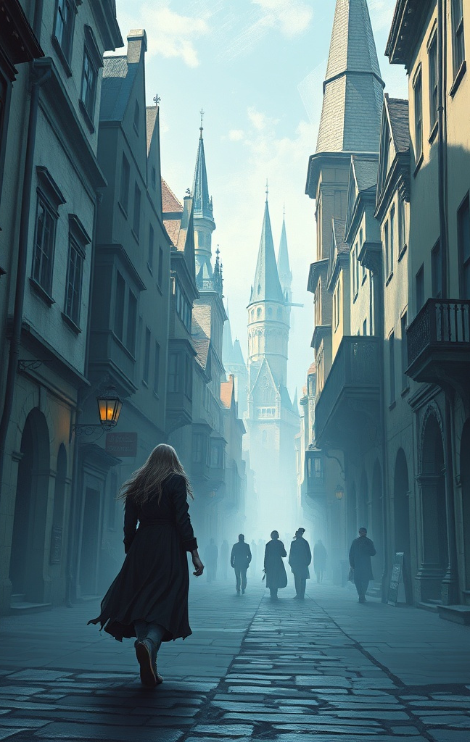
As I was leaving, this person asked me ”Where will you be going now?” I replied ‘ To Oxenfurt, I was ordered to travel from Novigrad to Oxenfurt and vice versa along with to write down the people’s behavior towards the new king and his kingdom and also the monsters and mystic places I find If I Survive;’
Seeing my condition being worse, equal to that of a “Respectable” woman walking alone in the streets of novigrad He offered his help by travelling with me to Oxenfurt but with one condition; That I should pay him after we reached the gates of Oxenfurt. As it was getting late night I had to accepted his offer as he did save me before.
Thus, we both were travelling together, two persons who know little about each other, well mostly me who don’t know anything; But the Prescence of having another person while travelling is quite good as I for one travel alone.
After we passed the boarder pass near Ursten, He told “ Wait here, I will go and check a safe place for us to rest” His eyes were looking for something which Confused me for a bit.

Slide 8
He gave me his sword for my own protection; When I asked ‘ Why, I don’t know how to use it properly?’ He replied; “When it comes to Life or Death every skill even the ones we do not know we will use so that we can survive. The bandits around are not so Friendly to the people like you”.
I questioned ‘ What are they are going to take?’ He replied “Your boots; They will kill you for your boots and probably sell them So, Be strong You will be Okay”. He said and left.
Even though we barley talked through-out the journey, He trusted me enough to give me one of his sword; I guess he likes to keep his “Luggage” safe by letting it go. The sword was easy to swing though, Good I guess.
After sometime; the winds nature changed, I was hearing weird noises, Crows shouting, animals making noises. I was afraid and this person did not arrive still.

Slide 9
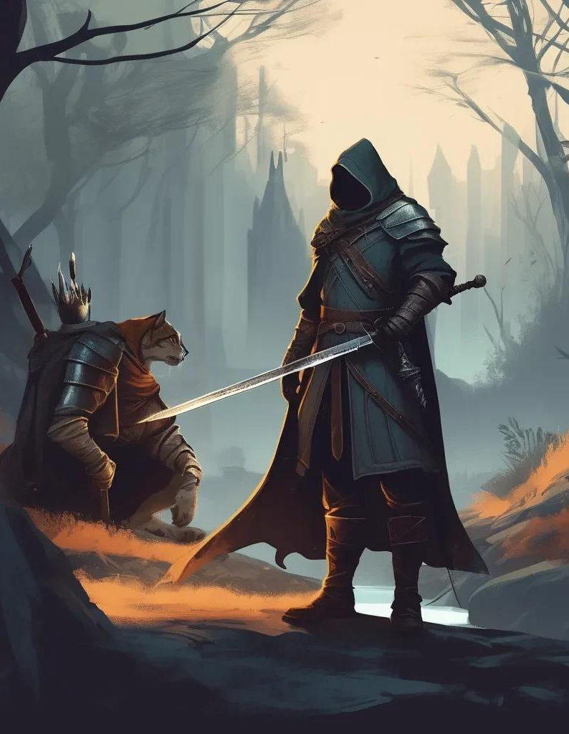
Suddenly I felt a cold air seeping through my spine, my hands, my body; I cannot move. I know that something scary/bad is behind me but I could not move to save myself. I thought my life was done. I felt I was a cat in a Hunter’s trap for a moment.
Then, I heard as monstrous scream, I got control over my body back and as I looked back there was nothing. The person came running towards me ”We need to go now!” His voice, He was afraid...... for me I guess.
We ran until he stopped me as there were bunch of crows perched on the nearby trees. The cold wind hurling; There was a voice in my head telling me to ‘kill HIM’, The person snapped me out of it.
He took his sword out and Started looking at all directions being ready for an attack. Out of now where he was hit hard and flew away.

Slide 10
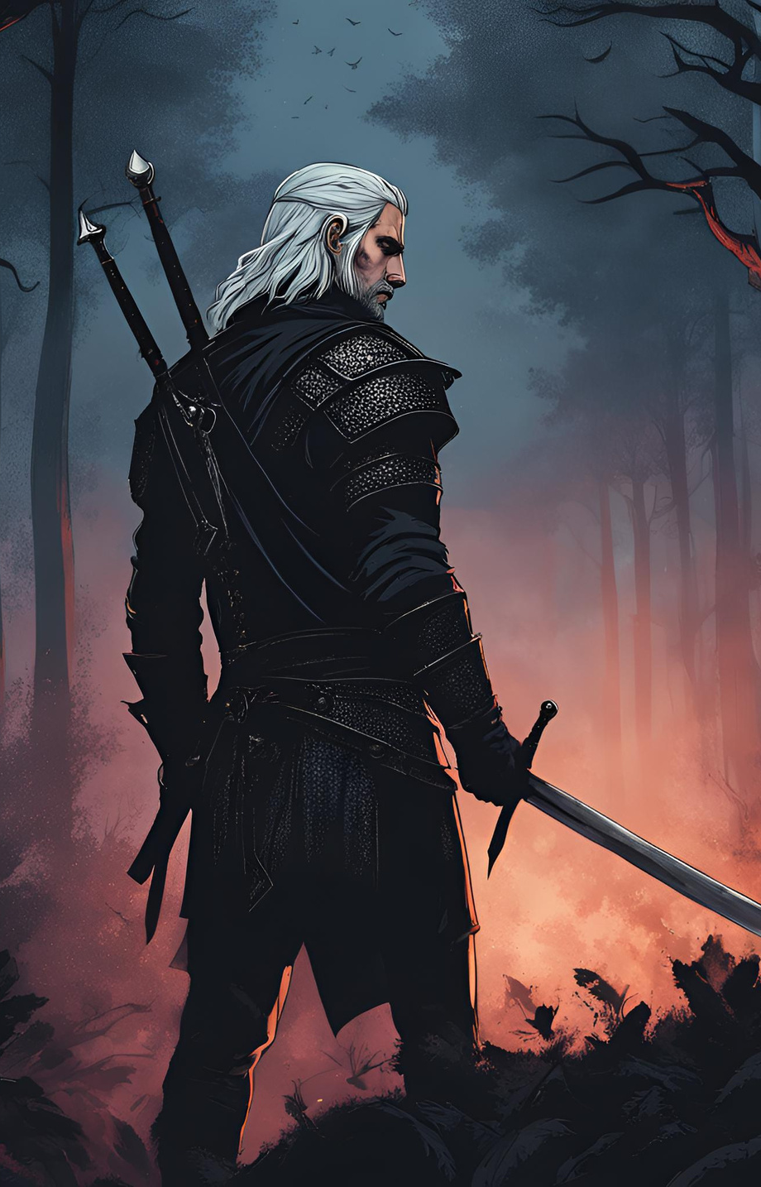
I got hit too and fell down as there was that giant Monstrosity coming towards me. I tried to hit it with the sword I had; It was a Success, In making It more angrier at me.
I ran and hid my self behind a tree praying to every god I know for my life, Out of now where that ‘thing’ appeared in front of me and I curled my self as it was about to Strike me; But A ‘Lightning’ Strike took it’s head clean off.
As I opened my eyes I saw; That person’s eyes glowing in the dark like feline creature and an amulet hanging from his neck.
I was in a shock ‘ I thought... I Thought you are dead, Your kind was killed long time ago?’ He replied as holding, supporting me “I am not who you think.” The person smiled and started to observe the corpse of that monster.
‘Whatever the truth maybe, Whatever transpired before; One thing is for sure that the person who saved me is without a doubt is the “One”. The one of few words which are forbidden to speak by the King’s rule; “The Witcher”, and my journey just begun as what was ahead of us is something beyond Your Imagination Itself.
Journey Continues.....

Slide 11
I hope the story meet your requirements, If or If not Thank you for taking time to read My short story; I have much more if you needed. Best Regards.
-Rathna Kamal

Slide 12
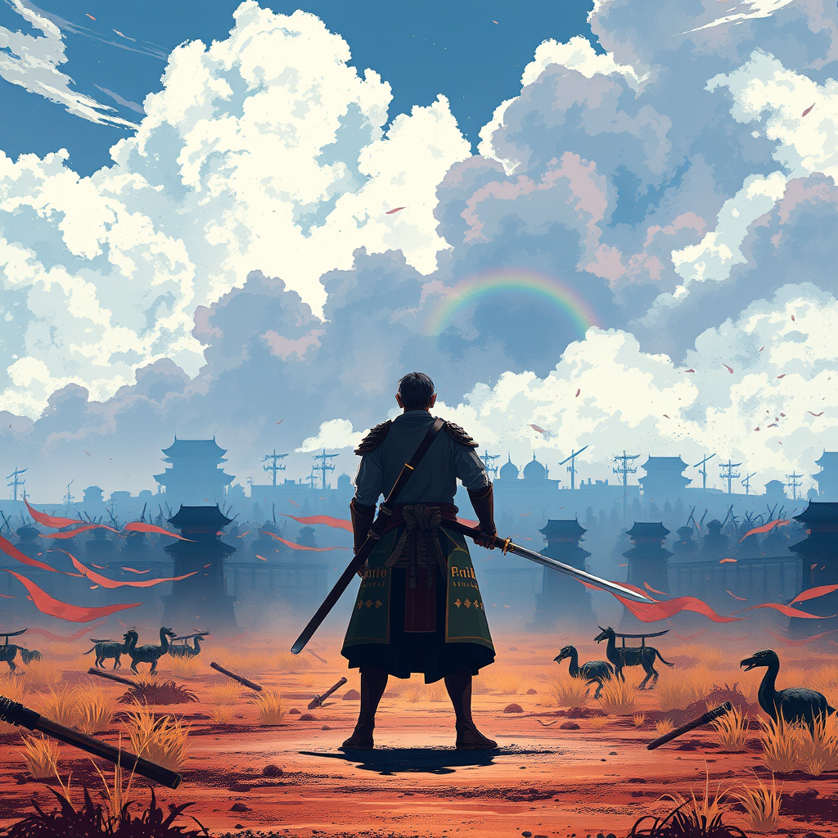
Email
Rathnakamaljonnalagadda2004@gmail.com
CONTACT

Slide 13
THANK YOU
Have a wonderful day with a glorious Life

